Slide 1
DEPARTMENT OF CSE , CSIT & AI&Ds
COURSE NAME – ADAPTIVE Software Engineering
COURSE CODE – 23CI2001
Topic: INTRODUCTION TO SCRUM, kanban

Slide 2
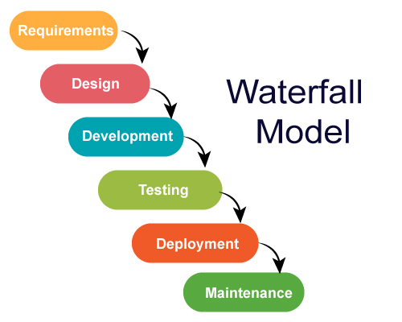
Advantages
Simple and easy to understand and use
Specific deliverable and review process
Phases do not overlap
Disadvantages
Not suitable for changing requirements
Unexpected results
Time to market is high

Slide 3
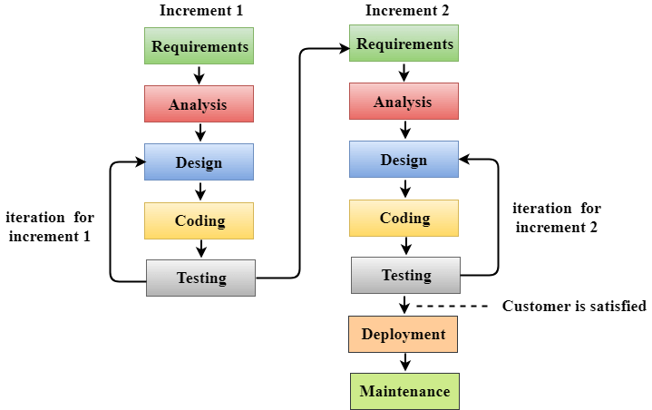
Agile is a philosophy, i.e., a set of values and principles to make a decision for developing software.
Agile is based on the iterative-incremental model. In an incremental model, we create the system in increments, where each increment is developed and tested individually.

Slide 4
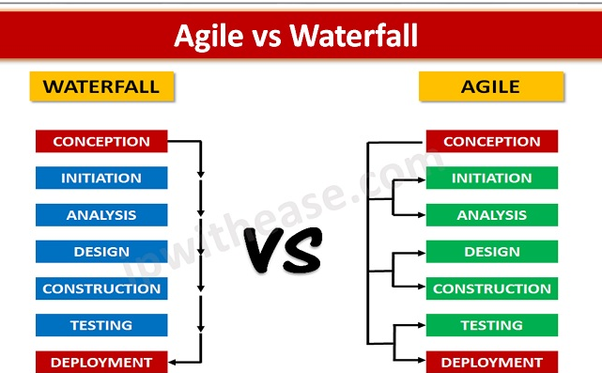
AGILE
SDLC
It takes an incremental and continuous iteration approach
It is sequential in order

Slide 5
Parametric comparison of AGILE and SDLC
PARAMETER | AGILE | SDLC
Classification | Sprints | phases
Approach | incremental | Sequential
Flexibility | flexible | Regid
Testing | After each sprint | After final phase
Focus | Satisfactory | Project completion
Managerial need | Team | Project manager
Suitability | Many Small projects | Single big project
Requirements | Day today | No room for change

Slide 6
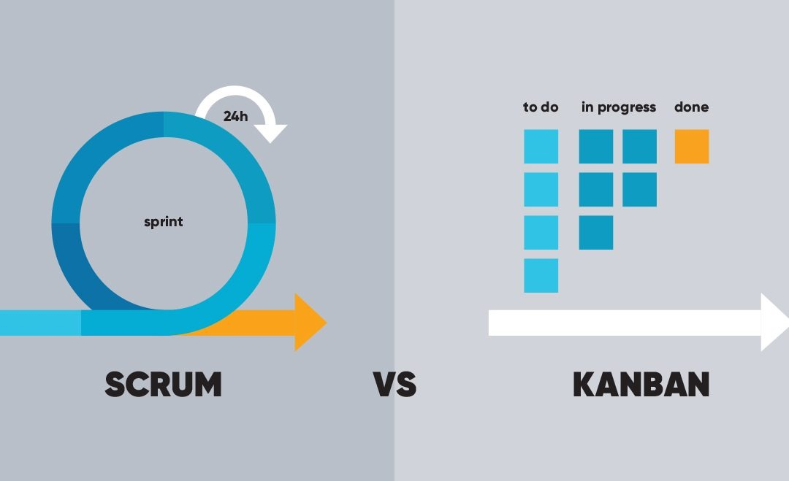
AGILE TYPES

Slide 7
SCRUM
SCRUM DEFINITION:
Scrum is an IID method that emphasizes a set of project management values and practices, rather than those in requirements, implementation, and so on. As such, it is easily combined with or complementary to other methods.
A key Scrum theme is its emphasis on empirical rather than defined process.
Scrum appears simple yet has practices that deeply influence the work experience and that capture key adaptive and agile qualities.

Slide 8
Some key practices include:
self-directed and self-organizing team
no external addition of work to an iteration, once chosen
daily stand-up meeting with special questions
usually 30-calendar day iterations
demo to external stakeholders at end of each iteration
each iteration, client-driven adaptive planning

Slide 9
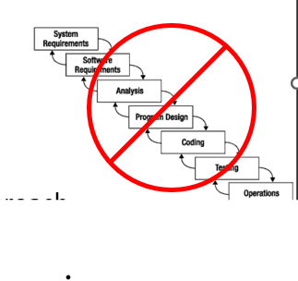
What is Scrum?
Is an agile, lightweight process
Can manage and control software and product development
Uses iterative, incremental practices
Has a simple implementation
Increases productivity
Reduces time
Embraces the opposite of the waterfall approach…

Slide 10
Scrum Origins:
Jeff Sutherland
Initial scrums at Easel Corp in 1993
IDX and 500+ people doing Scrum
Ken Schwaber
ADM
Scrum presented at OOPSLA 96 with Sutherland
Author of three books on Scrum
Mike Beedle
Scrum patterns in PLOPD4
Ken Schwaber and Mike Cohn
Co-founded Scrum Alliance in 2002, initially within Agile Alliance

Slide 11
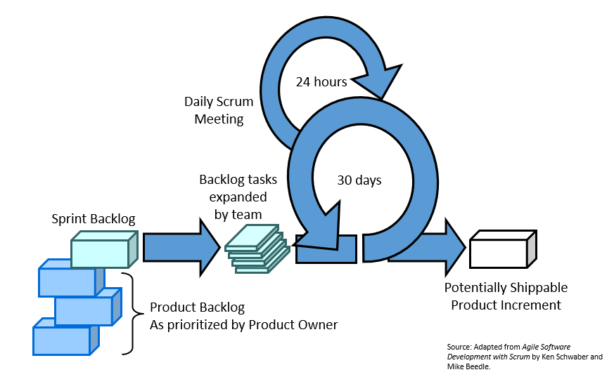
Scrum at a Glance:

Slide 12
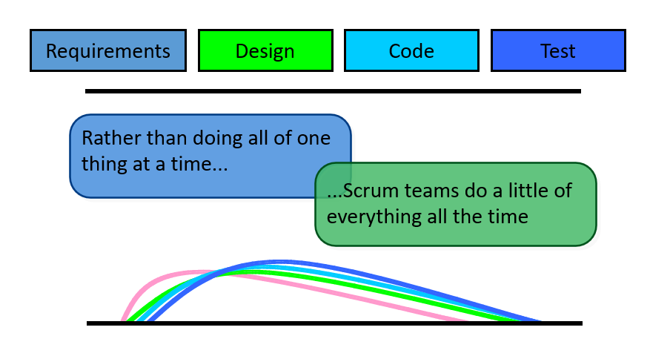
Sequential vs. Overlap:

Slide 13

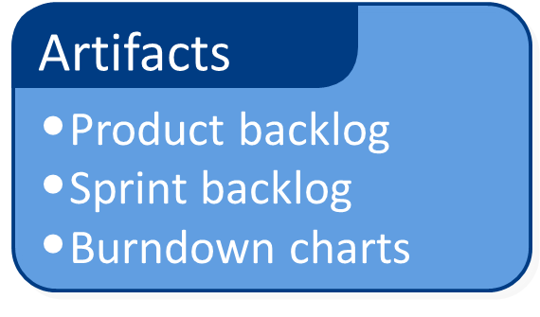
Scrum Framework
Roles
Product owner
Scrum Master
Team
Ceremonies
Sprint Planning
Sprint Review
Sprint Retrospective
Daily Scrum meeting

Slide 14







Scrum Roles:
Product Owner
Possibly a Product Manager or Project Sponsor
Decides features, release date, prioritization
Scrum Master
Typically a Project Manager or Team Leader
Responsible for enacting Scrum values and practices
Remove impediments / politics, keeps everyone productive
Project Team
5-10 members; Teams are self-organizing
Cross-functional: QA, Programmers, UI Designers, etc.
Membership should change only between sprints

Slide 15
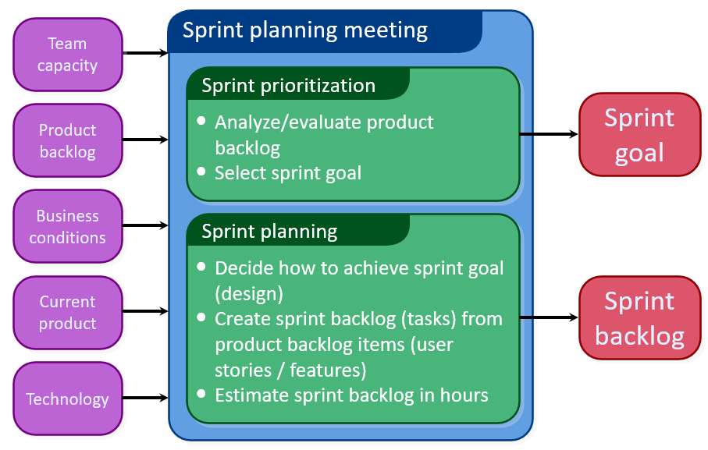
Sprint Planning Meeting:

Slide 16
Daily Scrum Meeting:
Parameters
Daily, 15 minutes, Stand-up
Anyone late pays a $1 fee
Not for problem solving
Whole world is invited
Only team members, Scrum Master, product owner, can talk
Helps avoid other unnecessary meetings
Three questions answered by each team member:
What did you do yesterday?
What will you do today?
What obstacles are in your way?

Slide 17
Scrum's Artifacts:
Scrum has remarkably few artifacts
Product Backlog
Sprint Backlog
Burndown Charts
Can be managed using just an Excel spreadsheet
More advanced / complicated tools exist:
Expensive
Web-based – no good for Scrum Master/project manager who travels
Still under development

Slide 18
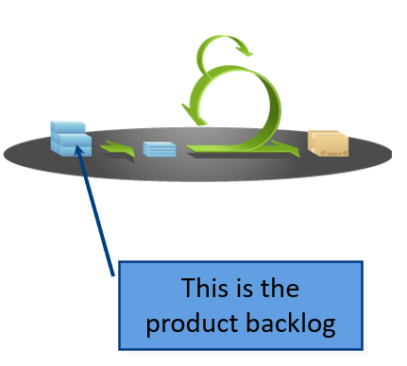
Product Backlog:
The requirements
A list of all desired work on project
Ideally expressed as a list of user stories along with
"story points", such that each item has value to
users or customers of the product
Prioritized by the product owner
Reprioritized at start of each sprint

Slide 19
User Stories:
Instead of Use Cases, Agile project owners do "user stories"
Who (user role) – Is this a customer, employee, admin, etc.?
What (goal) – What functionality must be achieved/developed?
Why (reason) – Why does user want to accomplish this goal?
As a [user role], I want to [goal], so I can [reason].

Slide 20
Example:
"As a user, I want to log in, so I can access subscriber content."
story points: Rating of effort needed to implement this story
common scales: 1-10, shirt sizes (XS, S, M, L, XL), etc.

Slide 21
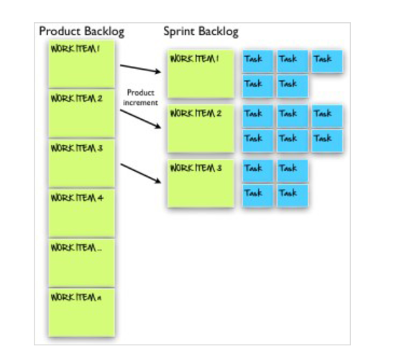
Product and sprint backlog

Slide 22
The Scrum Meeting: Details
The Scrum Meeting—or scrum—is the heartbeat of Scrum and the project. Each workday at the same time and place, hold a meeting with the team members standing in a circle, at which time the same special questions are answered by each member:
1. What have you done since the last Scrum?
2. What will you do between now and the next Scrum?
3. What is getting in the way (blocks) of meeting the iteration goals?
4. Any tasks to add to the Sprint Backlog
5. The last question provides an efficient forum for a continuously improving and learning group

Slide 23
Work products:
In addition to the work products illustrated , Scrum allows any other work products of value to the project.
Product Backlog
Sprint Backlog
Sprint Backlog Graph
Other Practices and Values
Workers daily update the Sprint Backlog
No PERT charts allowed
Scrum Master reinforces vision
Replace ineffective Scrum Master
VALUES: Commitment, Focus, Openness, Respect, Courage

Slide 24
Define SCRUM.
2. Describe the method Overview of scrum.
Sketch and explain Lifecycle of scrum.
Explain Work products, Roles, and Practices.
List out the advantages of Scrum Meeting.
List out the values of scrum.

Slide 25

THANK YOU
Team – ADAPTIVE SOFTWARE ENGINEERING

